Slide 1
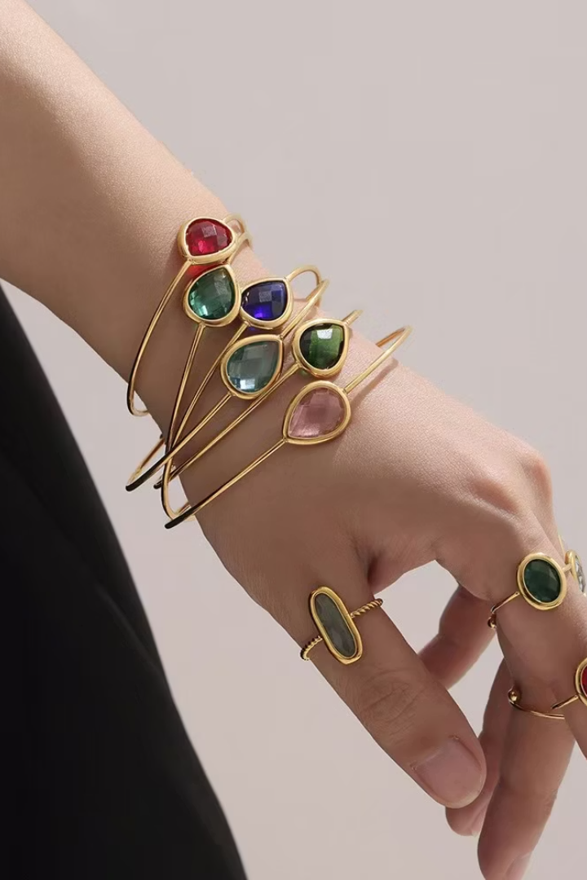
Fandi Fashion
Jewelry Catalog 2025
Welcome to our latest collection, designed to bring timeless elegance to every moment.
Discover exquisite pieces crafted for every style and occasion.

Slide 2
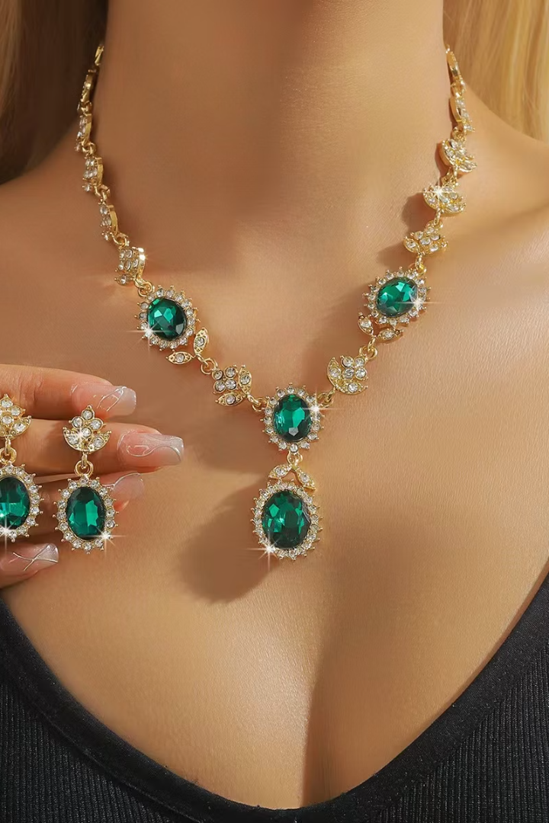



About Our Company
Quality Craftsmanship
Each piece designed for lasting beauty.
Affordable Luxury
Premium jewelry for every budget.
Diverse Styles
Jewelry for every occasion.
We are committed to exceptional quality, innovative design, and accessibility for all.

Slide 3
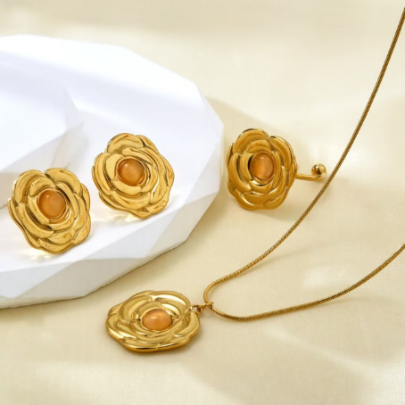
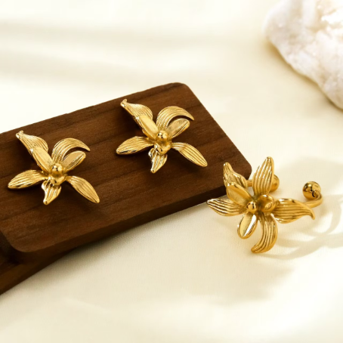
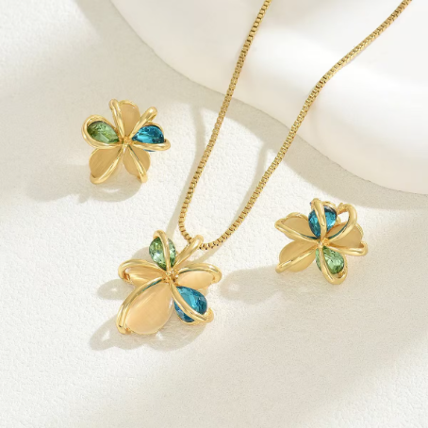
Gold Plated Collection
Luminous Finish
Hypoallergenic
Full Sets
Luxurious 18K gold layering.
Tarnish-resistant designs.
Necklace, earrings, ring, and bracelet available.

Slide 4
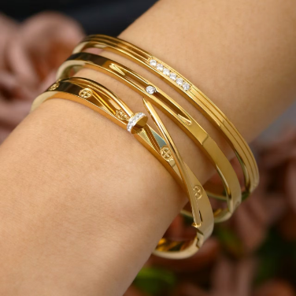
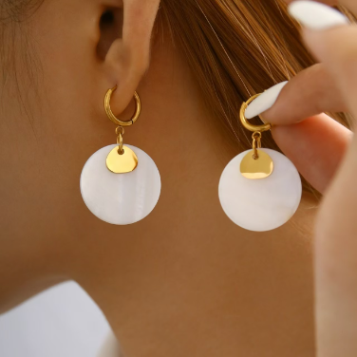
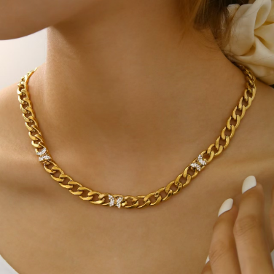
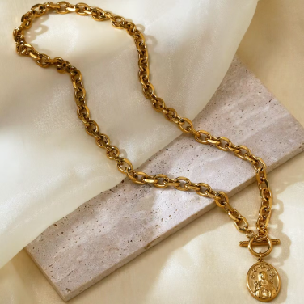
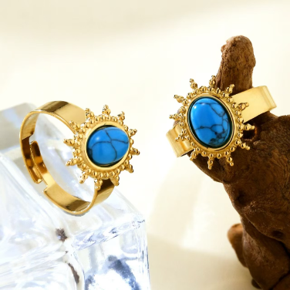
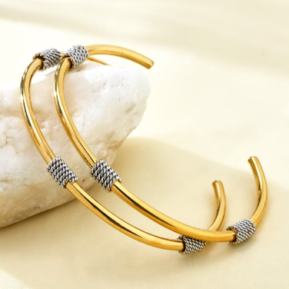

Slide 5
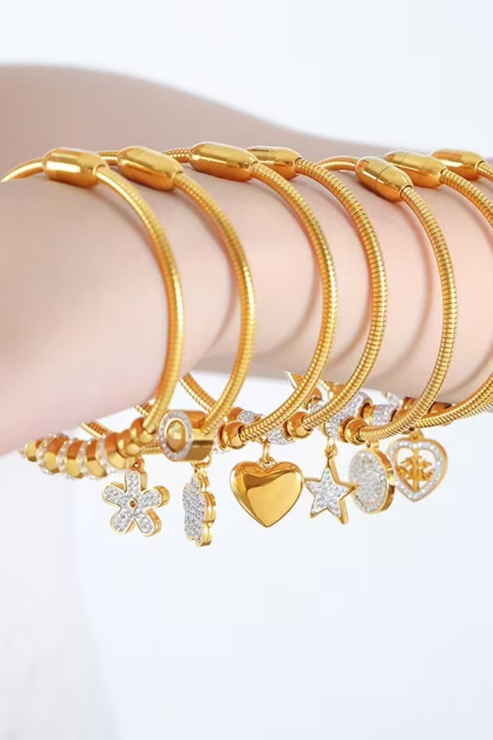



Titanium Steel Collection
High Durability
Modern Style
Complete Collection
Scratch-resistant alloy.
Sleek, high polish finish.
Includes necklace, earrings, ring, and bracelet.

Slide 6
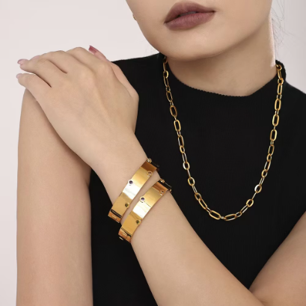
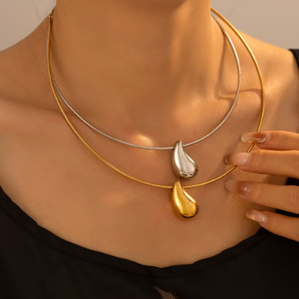
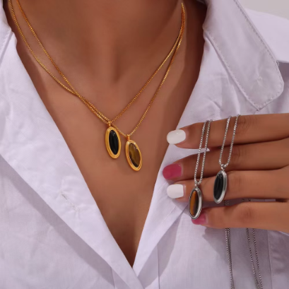
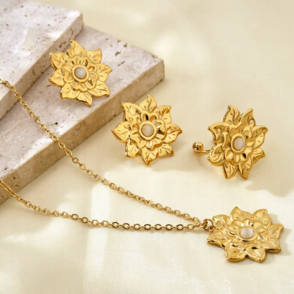
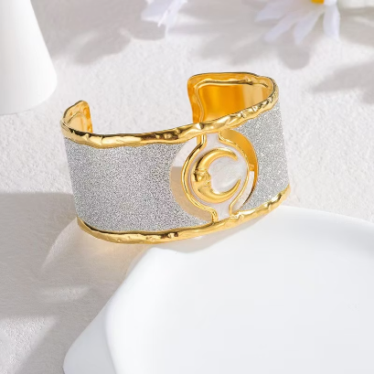
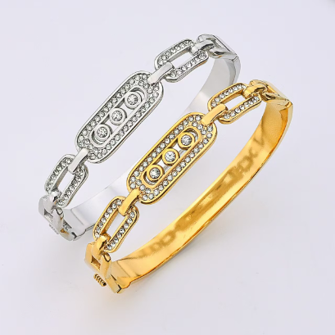

Slide 7
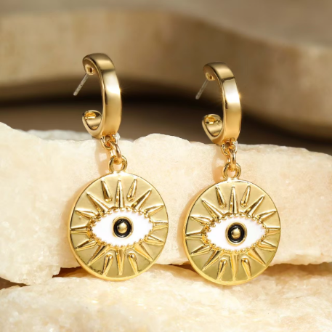
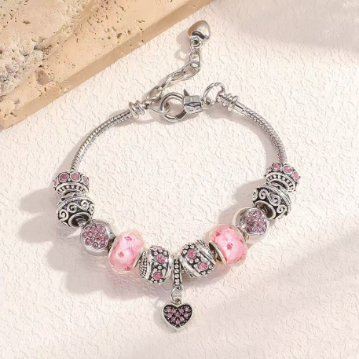
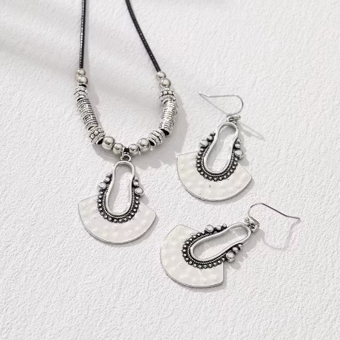
Alloy Collection
Lightweight Comfort
Versatile Designs
Diverse Platings
Easy to wear, ideal for all-day
Adaptable to various styles
Available in a spectrum of colors and finishes.
comfort.
and trends.

Slide 8
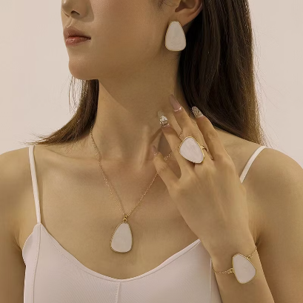
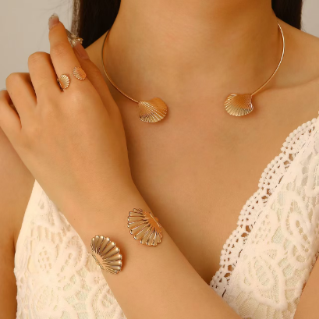
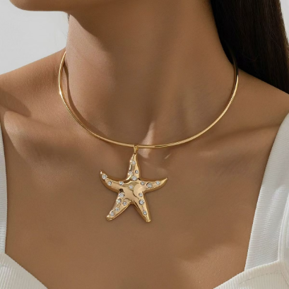
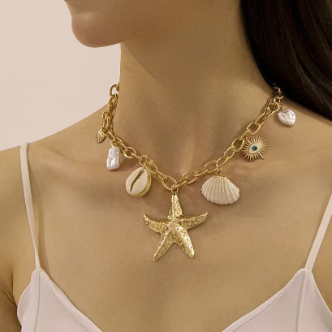
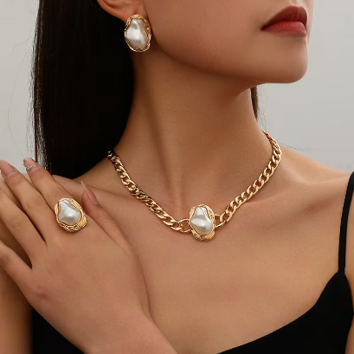
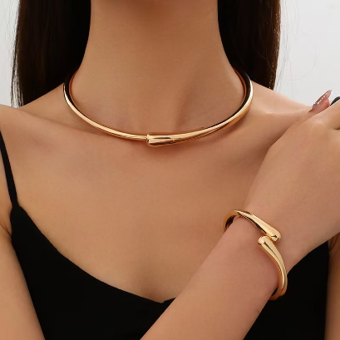

Slide 9
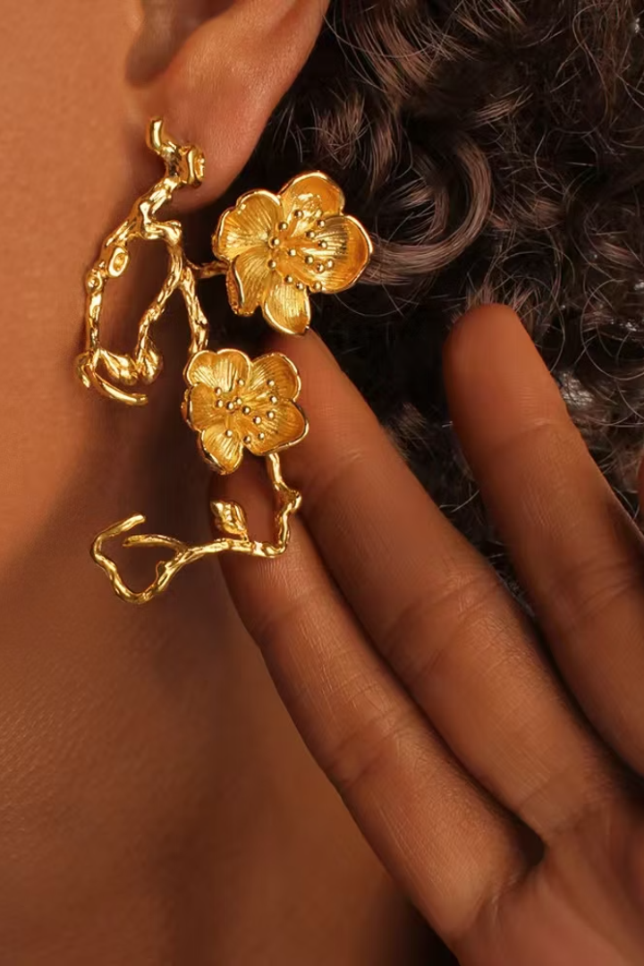
Brass Collection
1
Eco-Conscious
Sustainable, nickel-free brass base.
2
Vintage Appeal
Elegant, timeless details.
3
Full Range
Necklace, earrings, ring, and bracelet.

Slide 10
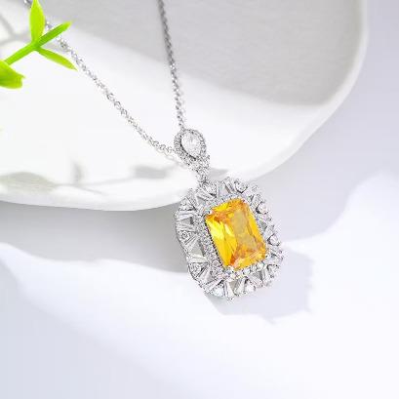
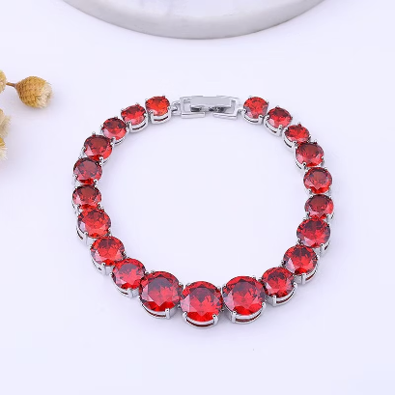
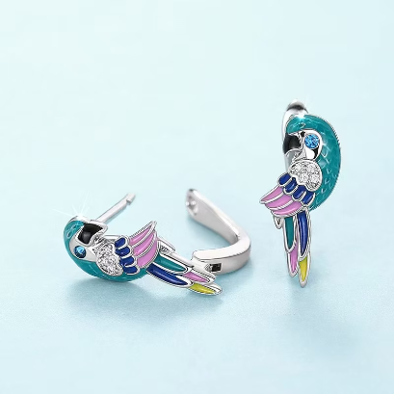
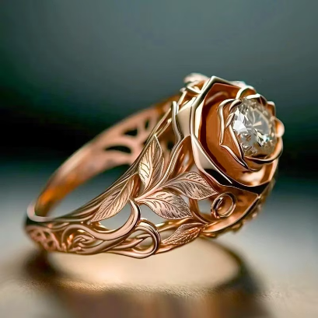
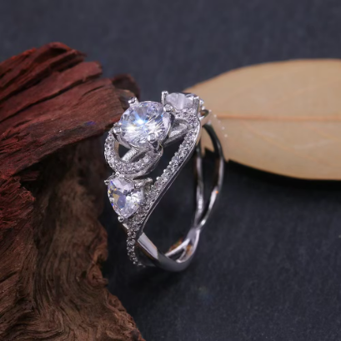
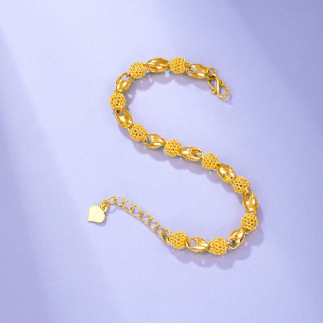

Slide 11
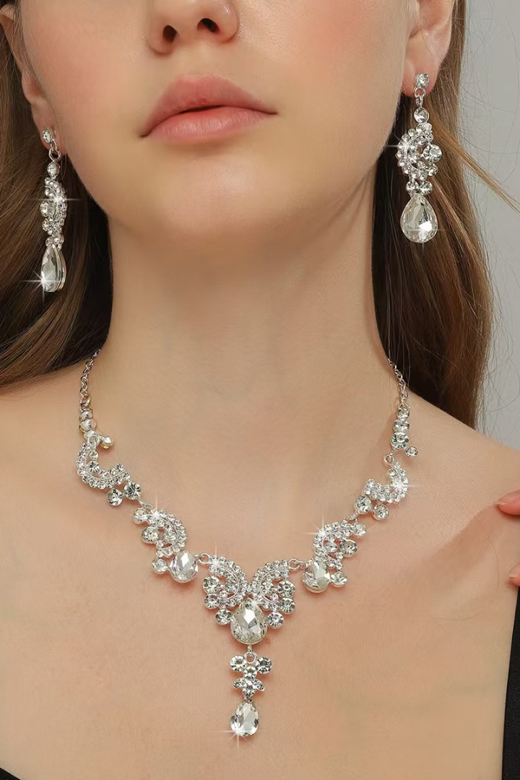



Rhinestone Collection
Brilliant Sparkle
High-grade rhinestones.
Statement Pieces
Perfect for special occasions.
Complete Sets
Necklace, earrings, ring, bracelet, headwear.

Slide 12
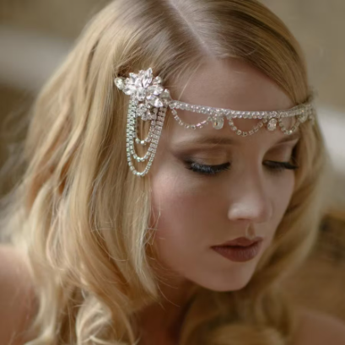
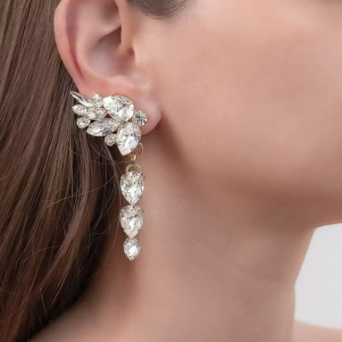
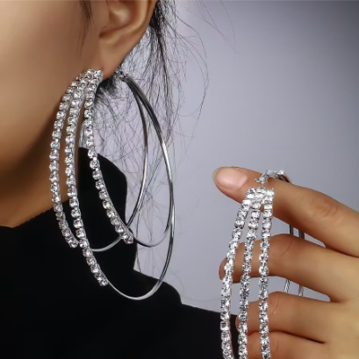
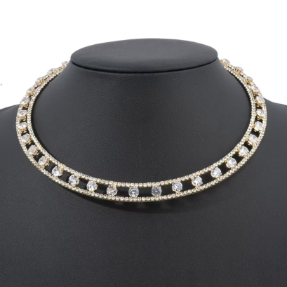
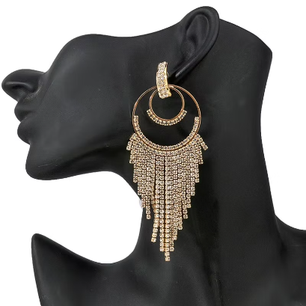
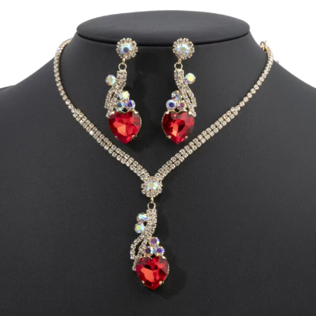

Slide 13



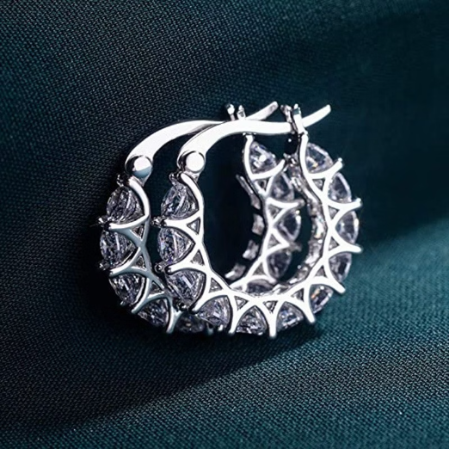
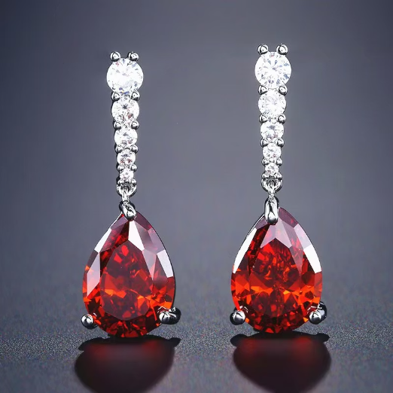
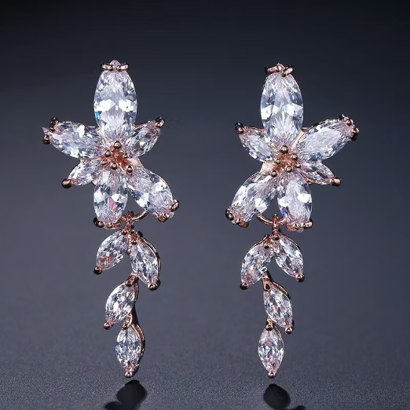
Cubic Zirconia Collection
Exceptional Brilliance
Precise Setting
All Pieces
Diamond-simulant quality.
Each stone hand-set.
Necklace, earrings, ring, bracelet available.

Slide 14
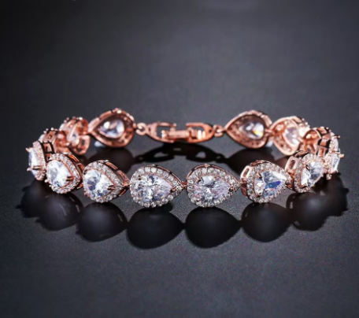
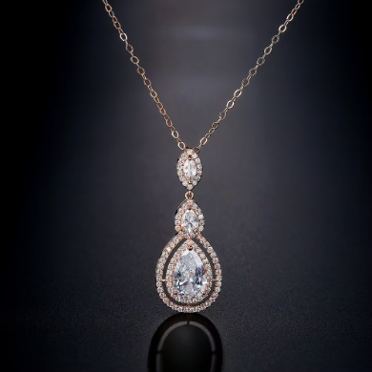
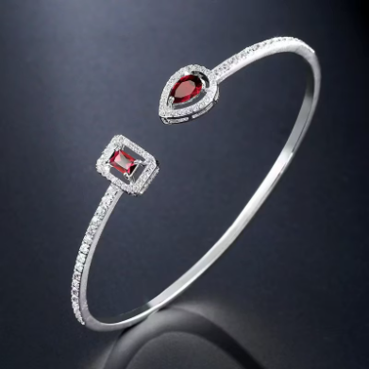
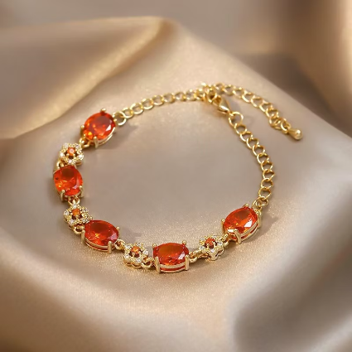
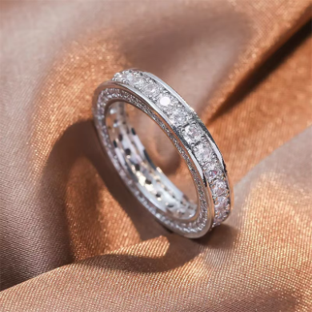
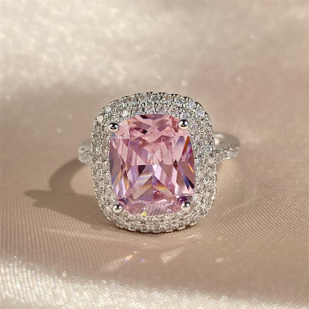

Slide 15



Pearl Collection
Genuine Pearls
Timeless Designs
Full Assortment
Freshwater and shell pearls.
Classic elegance with modern flair.
Necklace, earrings, ring, and bracelet.

Slide 16







Slide 17


How to Order & Contact Us
Customization
Sizes and personalized options available.
Global Delivery
Bulk discounts, fast worldwide shipping.
Get in Touch
Email: info@fandifashion.com
fannyhe@fandifashion.com
Phone/Wechat/WhatsApp: (+86) 180 3816 9530

